Slide 1
“Gear Model” to support Roadmapping of
Value Chain Dynamics
Cultural
Dynamics
Regulatory
Policy
Dynamics
Technology
& Innovation
Dynamics
Industry
Structure
Dynamics
Customer
Preference
Dynamics
Business
Cycle
Dynamics
Capital
Market
Dynamics
Interdependent sectors
represented as
intermeshed gears

Slide 2
Value Chain Dynamics:
A Three Part Drama
Natalie Klym (CFP Exec. Director
Charlie Fine (Sloan & CFP)
The New Normal:
Value Chain Oscillation &Temporary Advantage
-- Corporate Strategy & Industry Structure
Television Dynamics
From RCA to Twitch
The Ambiguity of Disruption
- The Future of Content
,

Slide 4
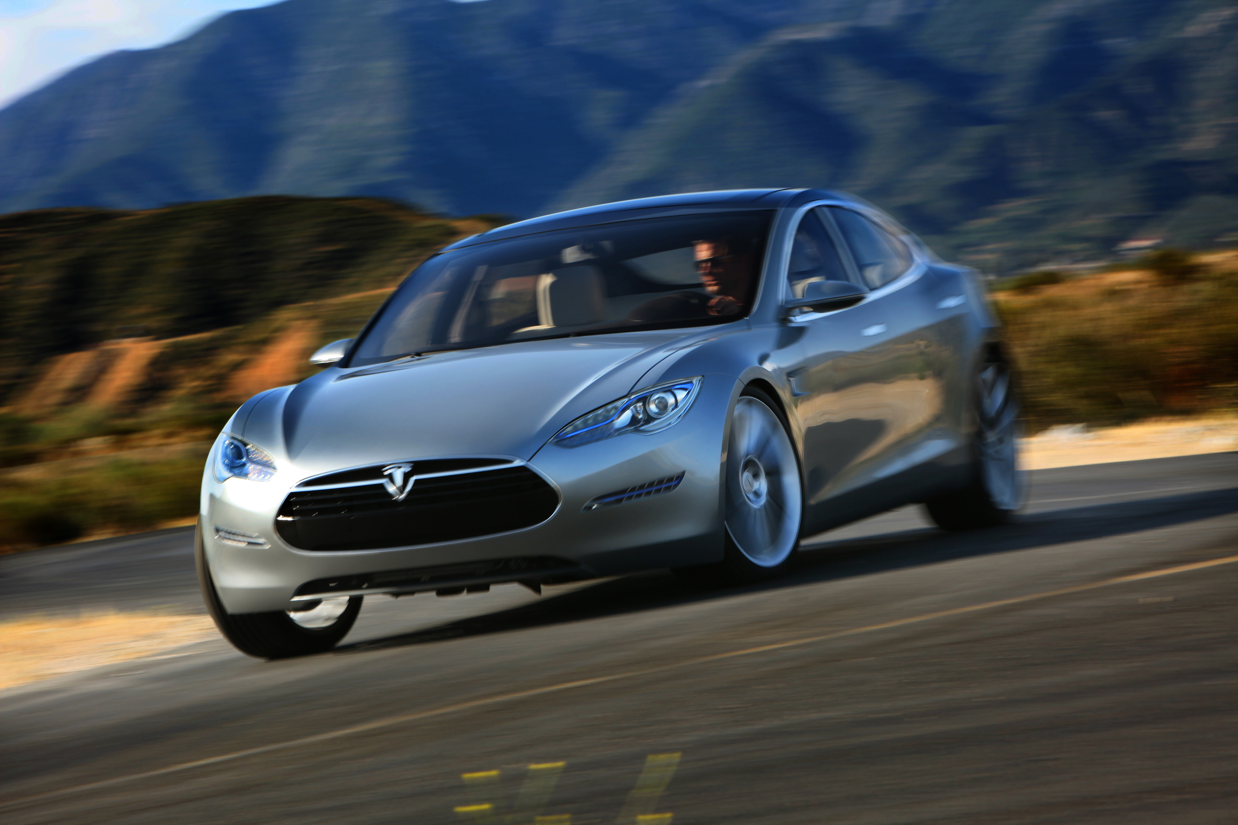
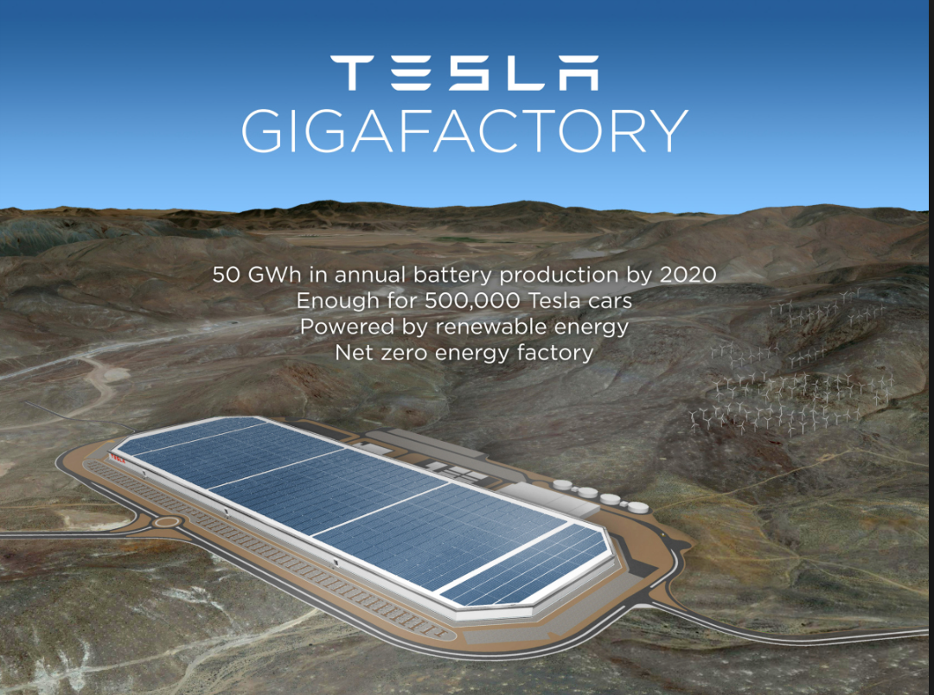

Slide 5
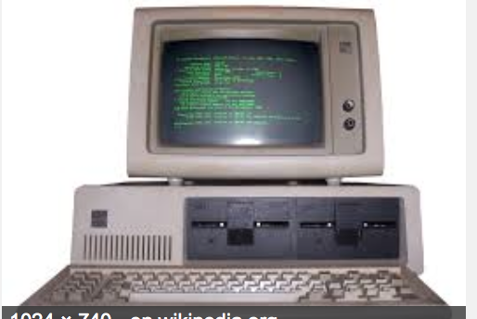

Slide 6
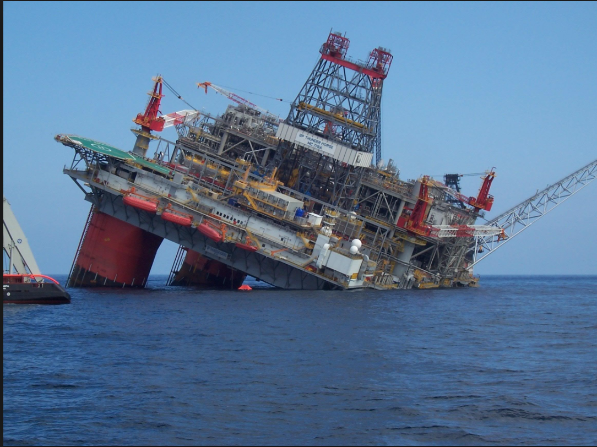
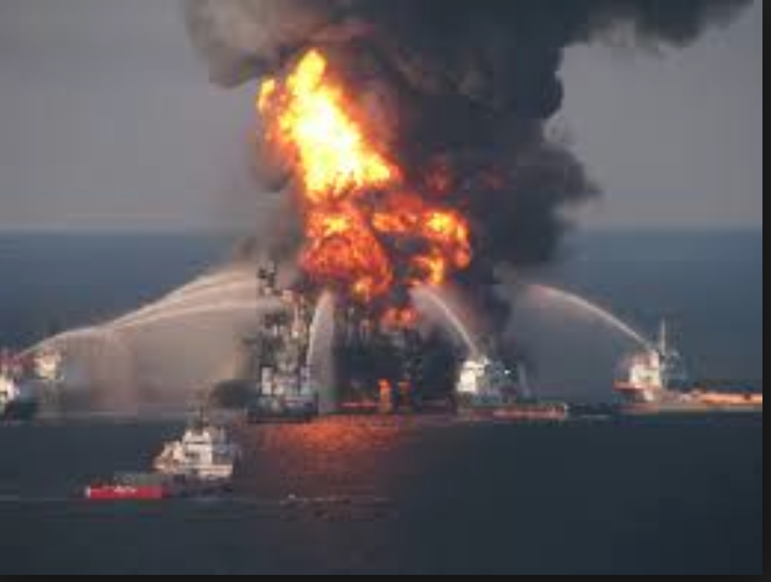

Slide 7
Value Chain Dynamics:
Corporate Strategy & Industry Structure
Prof. C Fine (Sloan & CFP)
Corporations complement technology/product
Strategy with value chain strategy
-- iPod/iPhone with iTunes
-- Tesla cars w/charging stations & giga-factory
Sometimes they make mistakes
IBM let Intel Inside (& Microsoft)
BP in Gulf of Mexico
Where will be the high value part of the value chain
- What is the “control point” of the value chain?
Can we model the “value chain dynamics” to help
“predict” control point changes?
“Double Helix” model attempts to capture some of the dynamics
-- See also Tim Wu’s “cycle” in The Master Switch,
Excerpts from

Slide 8
Vertical Industry Structure with Integral Product/System Architecture
Computer Industry Structure, 1975-85
IBM
DEC
BUNCH
Microprocessors
Operating Systems
Peripherals
Applications Software
Network Services
Assembled Hardware
All Products
All Products
All Products
(A. Grove, Intel; and Farrell, Hunter & Saloner, Stanford)
Notes:
In the 1975-85 timeframe, the computer industry had a vertical structure, with each firm offering distinct and largely incompatible systems.
Such a structure may be unstable since innovative firms may try to “pick off” slices of the business controlled by the “systems houses.”

Slide 9
Horizontal Industry Structure with Modular Product/System Architecture
Computer Industry Structure, 1985-95
Microprocessors
Operating Systems
Peripherals
Applications Software
Network Services
Assembled Hardware
Intel
Mac
TI
etc
Intel
Moto
AMD
etc
Microsoft
Mac
Unix
HP
Intel
Epson
Mac
TI
etc
Seagate
etc
etc
Microsoft
Lotus
Novell
etc
AOL/Netscape
Microsoft
EDS
etc
etc
HP
Compaq
IBM
Dell
etc
etc
(A. Grove, Intel; and Farrell, Hunter & Saloner, Stanford)

Slide 10
THE DYNAMICS OF PRODUCT ARCHITECTURE,
STANDARDS,AND VALUE CHAIN STRUCTURE:
“THE DOUBLE HELIX”
INTEGRAL PRODUCT
VERTICAL INDUSTRY
PROPRIETARY STANDARDS
MODULAR PRODUCT
HORIZONTAL INDUSTRY
OPEN STANDARDS
NICHE
COMPETITORS
INNOVATION & TECHNICAL ADVANCES
HIGH-
DIMENSIONAL
COMPLEXITY
SUPPLIER
MARKET POWER
PRESSURE TO
DIS-INTEGRATE
INCENTIVE TO
INTEGRATE
ORGANIZATIONAL
RIGIDITIES
PROPRIETARY SYSTEM
PROFITABILITY
Examples: IBM, Autos, Apple, Google, Nokia, Small Firms
Fine & Whitney, “Is the Make/Buy Decision Process a Core Competence?”

Slide 11
ALL COMPETITIVE ADVANTAGE
IS TEMPORARY
Autos:
Ford in 1920, GM in 1955, Toyota in 2000
Computing:
IBM in 1970, Wintel in 1990, Apple in 2010
World Dominion:
Greece in 500 BC, Rome in 100AD, G.B. in 1800
Sports:
Red Sox in 2007, Celtics in 2008, Yankees in 2009
The faster the clockspeed, the shorter the reign

Slide 12
What Drives Clockspeeds?
technology/innovation push, customer pull,
system complexity, branding, and regulation
Consumer
Handset or PC
Applications
Handset or PC
Platforms
Communications
Equipment
and Networks
Semiconductor
Components
Semiconductor
Manufacturing
Equipment

Slide 13
The Double Helix Redux

Slide 14
TV History Timeline
Late 40s-early 50s to present—OTA broadcast
Late 40s cable transmission of broadcast signals to remote areas
1953 microwave relay systems bring in distant broadcast signals via cable
1966 microwave technology brings additional broadcast signals
1970s –birth of cable TV networks (HBO 1972)
Early 1970s—cable TV networks emerge
due to the deregulation of satellites under the ‘Open Skies’ policy in the early 1970s, it became possible to distribute new programming for cable systems on a cheap, nationwide basis.”
1972 HBO is launched (the first “pay TV” network)
1975 – satellite MVPDs’ distribution of “cable TV” networks
Late 1990s – online video – shorts, ancillary content
mid-2000’s – telco FTTH/ IPTV MVPD distribution of “cable TV” networks
2005 – YouTube, iTunes

Slide 15
Original OTA model – Vertically Integrated
RCA as a Business model pioneer
Late 1940s - early 1950s
CREATION/PRODUCTION
(Shows)
DISTRIBUTION (programming: aggregating shows into channels, scheduling)
DELIVERY/TRANSMISSION
RECEPTION/PLAYBACK
Broadcast networks (ABC, CBS, NBC, Fox)
Broadcast networks (ABC, CBS, NBC, Fox)
Broadcast networks
(Lic. Spectrum)
CE manufacturers
(TV sets + antennas)
Vertical integration
Vertical integration across
PRODUCTION, DISTRIBUTION, DELIVERY
Distribution involved deciding which shows to produce (i.e., “curation”) and how to organize them according to a schedule (“programming”)

Slide 16
Early OTA model
– with Partial vertical dis-integration in production
CREATION/PRODUCTION
(Shows)
B2C DISTRIBUTION (programming: aggregating shows into channels)
DELIVERY/TRANSMISSION
RECEPTION/PLAYBACK
Broadcast networks (ABC, CBS, NBC, Fox)
Broadcast networks (ABC, CBS, NBC, Fox)
Broadcast networks
(Lic. Spectrum)
CE manufacturers
(TV sets + antennas)
Film studios
Independent TV producers
Outsourcing production allowed the TV networks to decrease cost/risk.
Partial vertical dis-integration

Slide 17
Enter cable… as simple “retransmission” of broadcast
Birth of CATV 1948
B2C DISTRIBUTION (programming: aggregating shows into channels)
CREATION/PRODUCTION
(Shows)
DELIVERY/TRANSMISSION
RECEPTION/PLAYBACK
Broadcast networks (ABC, CBS, NBC, Fox)
Broadcast networks
(Lic. Spectrum)
CE manufacturers
(TV sets + antennas)
Broadcast networks (ABC, CBS, NBC, Fox)
Film studios
Cable operators
Cable operators
(STB)
Independent TV producers
Initially, cable was just a transmission technology
Extended the reach of cable
Improved the quality of transmission
Good for the broadcasters since it increased viewership

Slide 18
Cable starts to DISTRIBUTE content,
competes with Broadcasters
1953 microwave relay systems bring distant broadcast signals
1966 microwave technology brings additional broadcast signals
B2C DISTRIBUTION (programming: aggregating shows into channels)
CREATION/PRODUCTION
(Shows)
DELIVERY/TRANSMISSION
RECEPTION/PLAYBACK
Broadcast networks (ABC, CBS, NBC, Fox)
Broadcast networks (ABC, CBS, NBC, Fox)
Broadcast networks
(Lic. Spectrum)
CE manufacturers
(TV sets + antennas)
Film studios
Cable operators
Cable operators
Cable operators
(STB)
Independent TV producers
Cable starts to distribute movies and import distant signals from out-of-market broadcasters (via satellite)
Functions like a broadcast network, aggregating broadcast shows (e.g., sports and movies)
Cable companies start to compete with local stations, who seek protection through PROGRAM RESTRICTIONS

Slide 19
Cable starts to distribute ORIGINAL CONTENT
1972 – HBO is launched
(the first “pay TV” network)
B2C DISTRIBUTION
(aggregation of channels)
CREATION/PRODUCTION
(Shows)
B2B DISTRIBUTION (programming: aggregating shows into channels)
DELIVERY/TRANSMISSION
RECEPTION/PLAYBACK
Broadcast networks (ABC, CBS, NBC, Fox)
Broadcast networks (ABC, CBS, NBC, Fox)
Broadcast networks
(Lic. Spectrum)
TV sets + antenna
(+ cable CAS)
Cable operators
(STBs)
Cable-affiliated networks (e.g., Discovery)
Cable-affiliated networks (e.g., Discovery)
Cable operators
(MVPDs)
Cable operators
(MVPDs)
Cable ready TVs become available (conditional access system embedded)
Pay TV broadcast networks (HBO, Showtime)
Pay TV broadcast networks (HBO, Showtime)
Multichannel Video Programming Distributor (MVPD) model adds a new intermediary layer to the value chain
TV is now a “paid” service, and viewers purchase bundles of multiple channels
Traditional broadcast programming is now separated from the delivery network
Film studios
Independent TV producers
Cablecos invest in (own) new programming networks:
“cable-affiliated networks”
Other, “independent” “pay TV” networks emerge (like HBO)
Notes:
due to the deregulation of satellites under the ‘Open Skies’ policy in the early 1970s, it became possible to distribute new programming for cable systems on a cheap, nationwide basis.” HBO (the first pay TV network) was launched in 1972, and in the same year, the FCC permitted cable’s entry into the top 100 markets. (Hazlett 1995)

Slide 20
Satellite enters a competing MVPD
1975 – satellite MVPDs’ distribution of “cable TV” networks
CREATION/PRODUCTION
(Shows)
B2B DISTRIBUTION (programming: aggregating shows into channels)
B2C DISTRIBUTION
(aggregation of channels)
DELIVERY/TRANSMISSION
RECEPTION/PLAYBACK
Broadcast networks (ABC, CBS, NBC, Fox)
Broadcast networks (ABC, CBS, NBC, Fox)
Broadcast networks
(Lic. Spectrum)
TV sets + antenna
STBs
(cable/satellite)
Cable-affiliated networks (e.g., Discovery)
Cable operators
(MVPDs)
Cable operators
(MVPDs)
Cable-affiliated networks (e.g., Discovery)
Cable-ready TVs
Satellite operators
(MVPDs)
Satellite operators
(MVPDs)
Pay TV broadcast networks (HBO, Showtime)
Pay TV broadcast networks (HBO, Showtime)
Satellite TV services emerge—same MVPD model as cable, different transmission technology
In order to prevent foreclosure/withholding content from the cable-affiliated networks, program access rules are established in 1992, expired 2012
Film studios
Independent TV producers

Slide 21
Enter telcos (FTTH/IPTV) as a competing MVPD
mid-2000’s – telco FTTH/ IPTV distribution of “cable TV” networks
CREATION/PRODUCTION
(Shows)
B2B DISTRIBUTION (programming: aggregating shows into channels)
B2C DISTRIBUTION
(aggregation of channels)
DELIVERY/TRANSMISSION
RECEPTION/PLAYBACK
Broadcast networks (ABC, CBS, NBC, Fox)
Broadcast networks (ABC, CBS, NBC, Fox)
Broadcast networks
(Lic. Spectrum)
TV sets + antenna
STBs
(cable/satellite)
Cable-affiliated networks (e.g., Discovery)
Cable-affiliated networks (e.g., Discovery)
Cable operators
(MVPDs)
Cable operators
(MVPDs)
Cable-ready TVs
Satellite operators
(MVPDs)
Satellite operators
(MVPDs)
Pay TV broadcast networks (HBO, Showtime)
Pay TV broadcast networks (HBO, Showtime)
Telco operators
(MVPDs)
Telco operators
(MVPDs)
Film studios
Telcos enter the industry, same basic model as MVPDs but different transmission technology – FTTH/IPTV
They had a hard time securing content deals at first, but today they are the fastest growing MVPD in terms of subscribers
Independent TV producers

Slide 22
The incumbent MVPD value chain
PRODUCTION (& MARKETING)
B2B DISTRIBUTION
B2C DISTRIBUTION & TRANSMISSION/DELIVERY
CONSUMPTION
Preproduction
Financing
Develop-ment
Production
(Creation)
B2B
Distribution
(Studios dist to TV networks)
B2B
Distribution
(TV Networks distribute to MVPDs)
B2C
Multi-channel aggregation
Distribution & Transmission
(MVPDs distribute to end users)
Viewing
Major Studios
Broadcast TV Networks
(ABC, NBC, etc.)
MVPDs
(cable, satellite, telcos)
(Comcast, TWC, etc.)
TVs
STBs
Connected TVs
Phones
tablets
Independent production companies
Basic Cable
TV Networks
(F/X, AMC, ESPN)
Affiliated (14%)
Non-affiliated (84%)
The great de-coupling: distribution is decoupled from the network, i.e., delivery or transmission is separated from B2C content aggregation (Internet as an “open” platform)
The great de-coupling
Cable TV Networks
“Original Production”
Pay TV
TV Networks
(HBO, Showtime)
Furthermore, the delivery infra is broken into CDNs and last-mile access. Netflix (and Apple?) have their own CDNs.
The entrant OVD value chain
Financing
Develop-ment
Production
(Creation)
B2B
Distribution
(Studios dist to OVDs)
B2C
Distribution
(OVDs distribute to end users)
B2B Delivery/
Transmission
CDN Interconnect.
B2C
Delivery/
Transmission
Access
Integration/
Aggregation
Search/access
Viewing
OVDs (e.g. Netflix, Amazon)
“Original Productions”
OVDs
(Netflix, Amazon, Hulu)
OVDs
Netflix, Apple)
Google?
Comcast?
Apple TV?
Android TV?
Amazon Fire
Tivo
TVs
Phones
tablets
End users
ISPs
ISPs
Wireless
ISPs
Wireless
ISPs
Notes:
And then along comes the Internet… (CF has talked about this in terms of the “OIPS”)
The great de-coupling: The main trigger leading to potential “disruption” – the OTT threat, was the decoupling of the transmission/delivery part of “content distribution.” The Internet provided an open delivery platform for new online-video distributors of all kinds, including the web sites of the traditional content producers and TV network distributors (typically for ancillary or catch up content, not as a competing window to the linear or MVPD VOD product, the latter having emerged around the same time given 2-way functionality of the analog to digital (not IP) switch of both OTA and cable delivery), as well as new online aggregators like iTunes, Netflix, and Hulu, as well as the web sites of new Web-native producers—including the “new media” aka “digital media” production arms of the studios and networks.
Furthermore, delivery has been split into CDN (B2B interconnection) and (last-mile) B2C access. I believe CDNs were originally third-party, like Akamai, Limelight, etc. (ask DC/BL), then network operators themselves (just the telcos?) started making their own, and eventually Netflix in 2012 announced it was building its own CDN (Open Connect)

Slide 23
The incumbent MVPD value chain
PRODUCTION (& MARKETING)
B2B DISTRIBUTION
B2C DISTRIBUTION & TRANSMISSION/DELIVERY
CONSUMPTION
Preproduction
Financing
Develop-ment
Production
(Creation)
B2B
Distribution
(Studios dist to TV networks)
B2B
Distribution
(TV Networks distribute to MVPDs)
B2C
Multi-channel aggregation
Distribution & Transmission
(MVPDs distribute to end users)
Viewing
Major Studios
Broadcast TV Networks
(ABC, NBC, etc.)
MVPDs
(cable, satellite, telcos)
(Comcast, TWC, etc.)
TVs
STBs
Connected TVs
Phones
tablets
Independent production companies
Basic Cable
TV Networks
(F/X, AMC, ESPN)
Affiliated (14%)
Non-affiliated (86%)
Double helix, double whammy
The OVDs are competing with (disrupting) both the MVPDs as “quasi” MVPDs, as well as the TV networks with a combination of (rebundled) “syndicated” content and original programming.
Cable TV Networks
“Original Production”
Pay TV
TV Networks
(HBO, Showtime)
The entrant OVD value chain
Financing
Develop-ment
Production
(Creation)
B2B
Distribution
(Studios dist to OVDs)
B2C
Distribution
(OVDs distribute to end users)
B2B Delivery/
Transmission
CDN Interconnect.
B2C
Delivery/
Transmission
Access
Integration/
Aggregation
Search/access
Viewing
OVDs (e.g. Netflix, Amazon)
“Original Productions”
OVDs
(Netflix, Amazon, Hulu)
OVDs
Netflix, Apple)
Google?
Comcast?
Apple TV?
Android TV?
Amazon Fire
Tivo
TVs
Phones
tablets
End users
ISPs
ISPs
ABC.com
(Hulu?)
Wireless
ISPs
Wireless
ISPs
Notes:
Double Helix, double whammy

Slide 24
The incumbent MVPD value chain
PRODUCTION (& MARKETING)
B2B DISTRIBUTION
B2C DISTRIBUTION & TRANSMISSION/DELIVERY
CONSUMPTION
Preproduction
Financing
Develop-ment
Production
(Creation)
B2B
Distribution
(Studios dist to TV networks)
B2B
Distribution
(TV Networks distribute to MVPDs)
B2C
Multi-channel aggregation
Distribution & Transmission
(MVPDs distribute to end users)
Viewing
Major Studios
Broadcast TV Networks
(ABC, NBC, etc.)
MVPDs
(cable, satellite, telcos)
(Comcast, TWC, etc.)
TVs
STBs
Connected TVs
Phones
tablets
Upstream fragmentation triggers downstream aggregation/integration
(“platform leadership?”)
Independent production companies
Basic Cable
TV Networks
(F/X, AMC, ESPN)
Catalog fragmentation has created an opportunity for
aggregated search (multi-OVD)
integrated access (MVPD + OVD) downstream.
“The handset will drive who wins.”
“The tail is wagging the dog.” (R. Saracco)
Or: will the ISPs win—what is the “product”/value prop? Content or access? See Steve Muir’s email.
Affiliated (14%)
Non-affiliated (84%)
Cable TV Networks
“Original Production”
Pay TV
TV Networks
(HBO, Showtime)
The entrant OVD value chain
Financing
Develop-ment
Production
(Creation)
B2B
Distribution
(Studios dist to OVDs)
B2C
Distribution
(OVDs distribute to end users)
B2B Delivery/
Transmission
CDN Interconnect.
B2C
Delivery/
Transmission
Access
Integration/
Aggregation
Search/access
Viewing
OVDs (e.g. Netflix, Amazon)
“Original Productions”
OVDs
(Netflix, Amazon, Hulu)
OVDs
Netflix, Apple)
Google?
Comcast (ISP)
Apple TV?
Android TV?
Amazon Fire
Tivo
TVs
Phones
tablets
The OVDs are highly fragmented. Although there is overlap among catalogs, there is enough “exclusivity,” combined with a low-enough price point that most OVD users subscribe to multiple services, spending on average $30/month (up to !00+ if sports packages are included).
End users
ISPs
ISPs
Wireless
ISPs
Wireless
ISPs
Notes:
The online video distributors are such a mix of services that we need to break them down into meaningful categories, i.e., those that have implications for whether they are extensions of the traditional television ecosystem (i.e., new distribution windows), complementary content (i.e., content that viewers would like in addition to traditional TV content, but not necessarily instead of), have the potential to disrupt.
iTunes and Amazon Instant Video are considered part of the “home video” market – these are PPV rent or own and compete directly with MVPD VOD services and DVDs. (Verify these are all the same release window)
Netflix, Amazon Prime, and YouTube’s “rentals” are all new “streaming” services. These comprise a different set of rights/licensing. They are generally a later release window than the home video market. Note that release structures for film and TV are different.
The entire window construct is collapsing…

